Slide 1

Intro to Programming
Automattic Grand Meetup 2014 Code Academy

Slide 2
Prerequisites
A text editor, such as Atom.io or Sublime Text
A GitHub account
GitHub for Mac - https://mac.github.com/
The Virtual Machine - https://github.com/nickdaugherty/intro-to-programming-2014

Slide 3
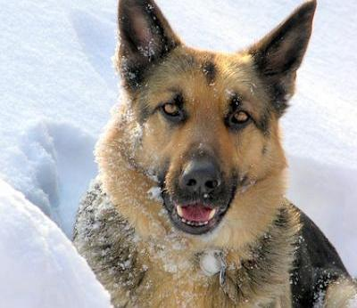
Computers only do what you tell them.
Faithfully carry out your commands
No free-will, behave predictably
Won't make it up as they go
Don't stop to consider their place in the world

Slide 4

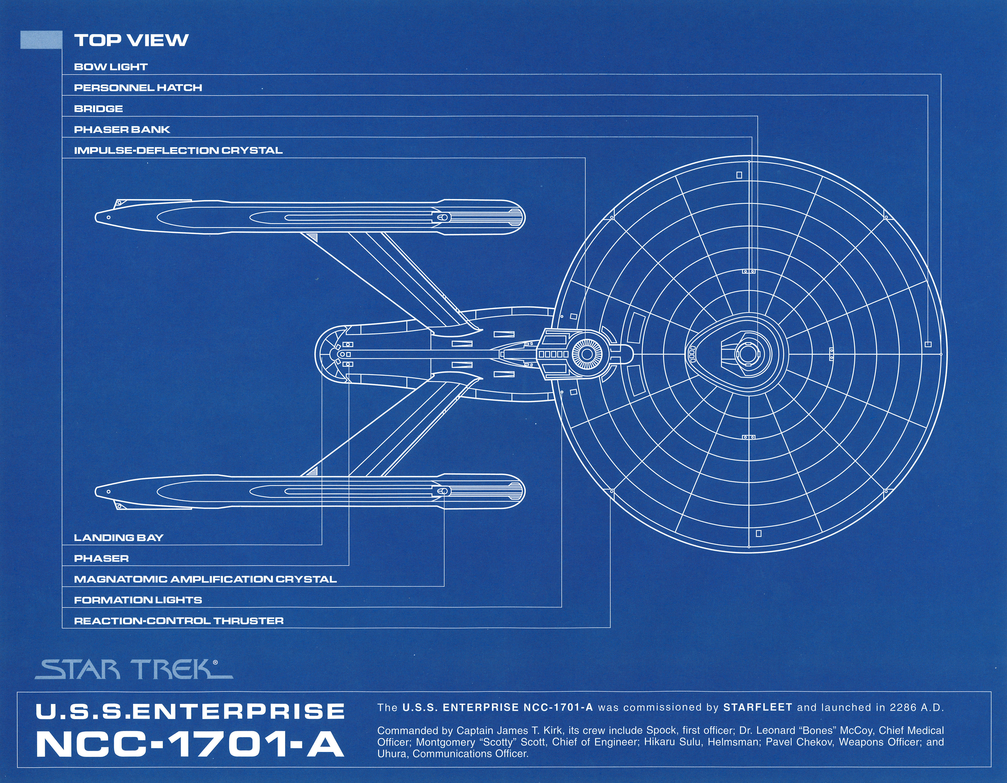
A program is a blueprint.

Slide 5
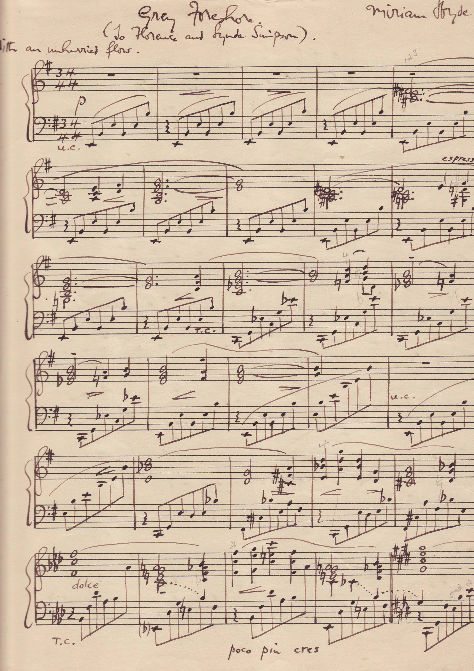
It reads like a book, or music...
Top to bottom
Left to right
Always in order
Follows the written instructions exactly

Slide 6
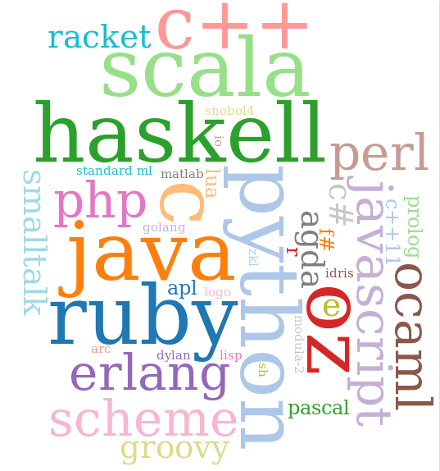
...with its own language.

Slide 7
Programming concepts are universal and language agnostic.
Once you begin to think like a programmer, moving between languages is learning the syntax; the same concepts always apply.

Slide 8
Programs can be simple...
echo 'hello world!';

Slide 9
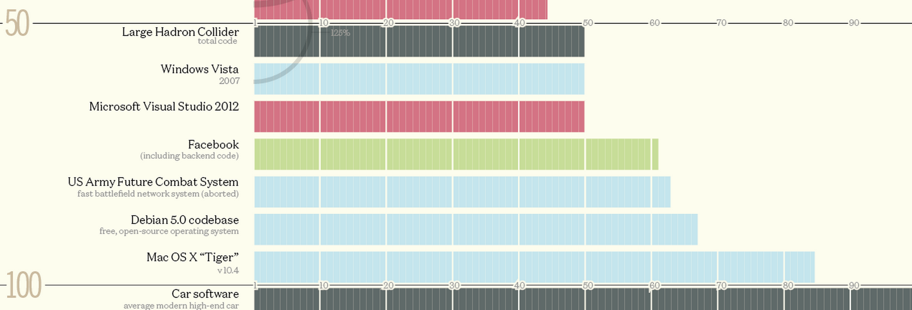
Or complex...

Slide 10
But every program, like every problem, can be broken down into simpler, more manageable chunks, that when combined, produce complexity.
Complex programs are merely the combination of many simpler chunks of functionality.

Slide 11
Building Blocks
To a computer, everything is a binary yes or no
1's and 0's all the way down
Processors only do very simple calculations
Modern programming languages abstract this away
Layers upon layers of code to execute our code

Slide 12

Basic Components
Variables
Functions
Flow Control (if / else, loops)
Comparisons (gt, lt, eq)

Slide 13
Variables
A program's 'memory'
Stores information for later use
Holds nearly anything
Changeable at any time
Like a Post Office Box – one of many, info is placed in and is retrieved, by address, later on
$is_jumping = true
$color = 'blue'
$price = 19.99
$sum = $a + $b + $c
$dog = new Dog()

Slide 14
Variables
Variables are assigned with = (single equals sign), the 'assignment operator'
Many languages such as PHP signify variables with a $, followed by the name
Variable names cannot start with a number
A good variable name is descriptive and indicates what it will hold.
$x_objects // Bad
$posts // Good!

Slide 15
Functions
Re-usable chunks of logic
Represents a single, simple 'unit of work'
A mini blueprint, for a specific task
Can call other functions
function jump(){
if ( $is_jumping ) {
return;
}
$is_jumping = true;
bend_down();
apply_force();
}

Slide 16
Functions
The keyword 'function', followed by a space, then the function name
Parenthesis designate the arguments to the function
Arguments are the optional 'input' – how high to jump or how loud to bark
Can return a value back to the caller, or not

Slide 17
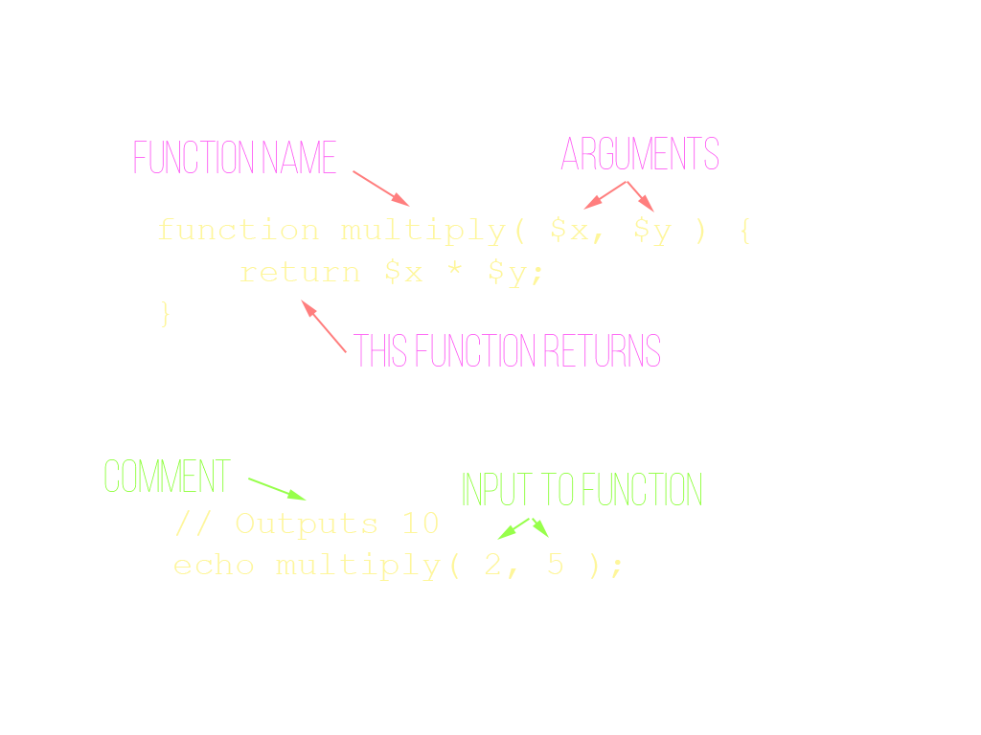

Slide 18
Conditionals
How our program makes decisions
Represents distinct paths of execution
Always a yes or no answer
if ( $is_raining ) {
turn_on_headlights();
$max_speed = 55;
} else {
turn_off_headlights();
$max_speed = 75;
}
set_max_speed( $max_speed );

Slide 19
Comparisons
$a == $b // Double equal sign!
$a != $b
$a < $b // Or $a > $b
$a >= $b // Or $a <= $b
( $a == $b ) && ( $c < $d )
Equality
Not equal
Greater than / less than
And / Or
Used with conditionals to give decision making power

Slide 20
Version Control
Version control is how we track changes in files and applications over time
Easily view exactly what was changed, and why
Instant backup!
Never overwrite your work
Identify when bugs were introduced
Tell others why you made a change

Slide 21
HTML Primer
Series of nested tags
Most tags have an open and a close
Name of tag determines what it does
Tags can have attributes that modify them
<div>
<em>Italic</em>
<strong>Bold</strong>
<br />
<img src=”/image.jpg” />
</div>

Slide 22
PHP Primer
Always needs an opening <?php tag
Then a closing ?> tag
Each line ends with a semi-colon ;
Whitespace is ignored
Runs on the server
'Language of the web'
What WP is written in
Ubiquitous
<?php echo 'hi'; ?>

Slide 23
Exercises!
See exercises 1-3 in the VM

Slide 24
Arrays
Arrays represent a list of data as a single variable
Can be looped over
Can be searched
$names = array(
'John',
'Sue',
'Jill',
'Bob'
);
$prime_numbers = array(
2,
3,
5,
7,
11
);

Slide 25
Loops
Iterate over an array
Execute a section of code x times
Loop while a condition is true
foreach loops over an array
for executes x number of times
while runs while a condition is true

Slide 26
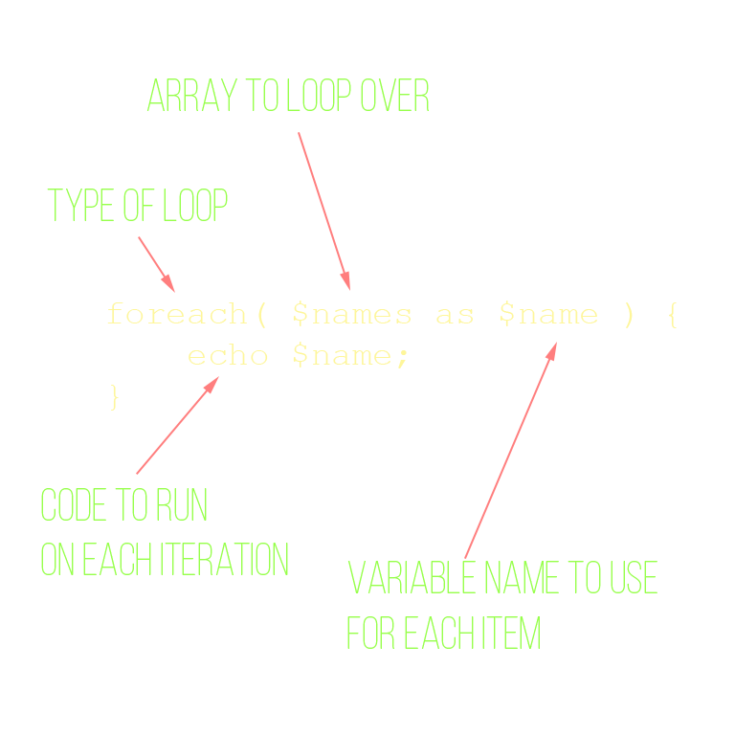
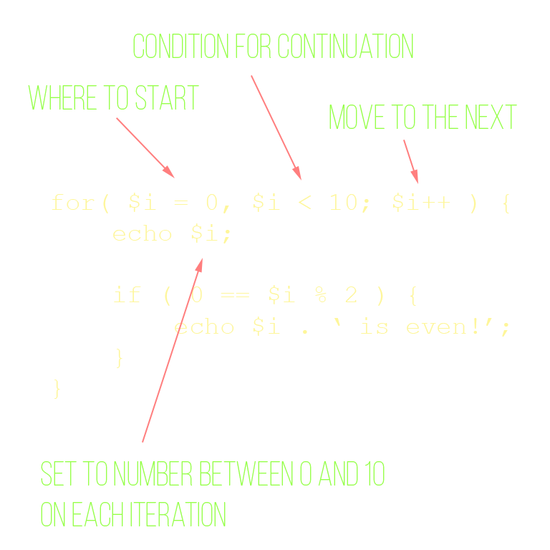
Loops

Slide 27
Exercises!
See exercises 4-6 in the VM

Slide 28
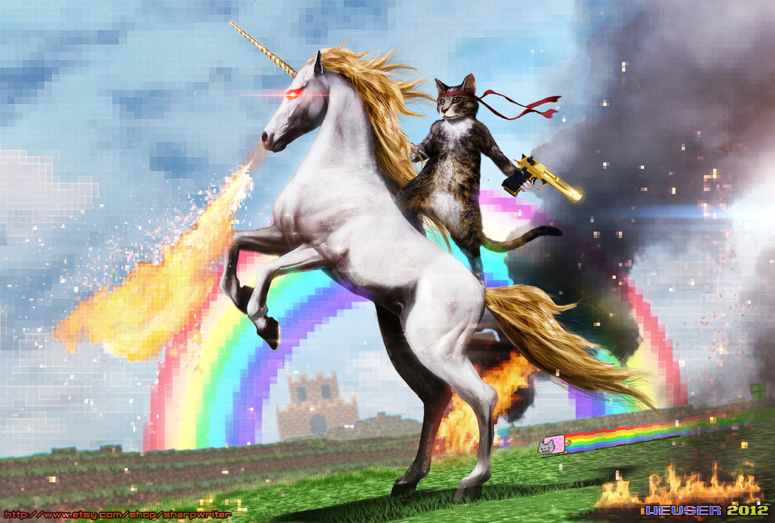
The Internet
Based on client/server model
Client (browser) requests a page from the server
Server processes the request, returns HTML, browser decides how to present it to the user

Slide 29
JavaScript
Programming language of the browser
Similar syntax to PHP (based on C)
Useful for handling user interactions, ajax requests, animations, etc
Sent in HTML, wrapped in <script> tags
Or, in a standalone file, included via <script src=”/path/to/file.js”>

Slide 30

jQuery
JavaScript library designed to make our lives easier and more fulfilling
Simplifies user interaction, ajax, animations
Don't leave home without it!

Slide 31
User Interaction
Events can happen in the lifetime of a page
JavaScript can respond to these events by executing code, known as callbacks
User clicks a button
User enters text
An image loads
Remote content is dynamically loaded

Slide 32
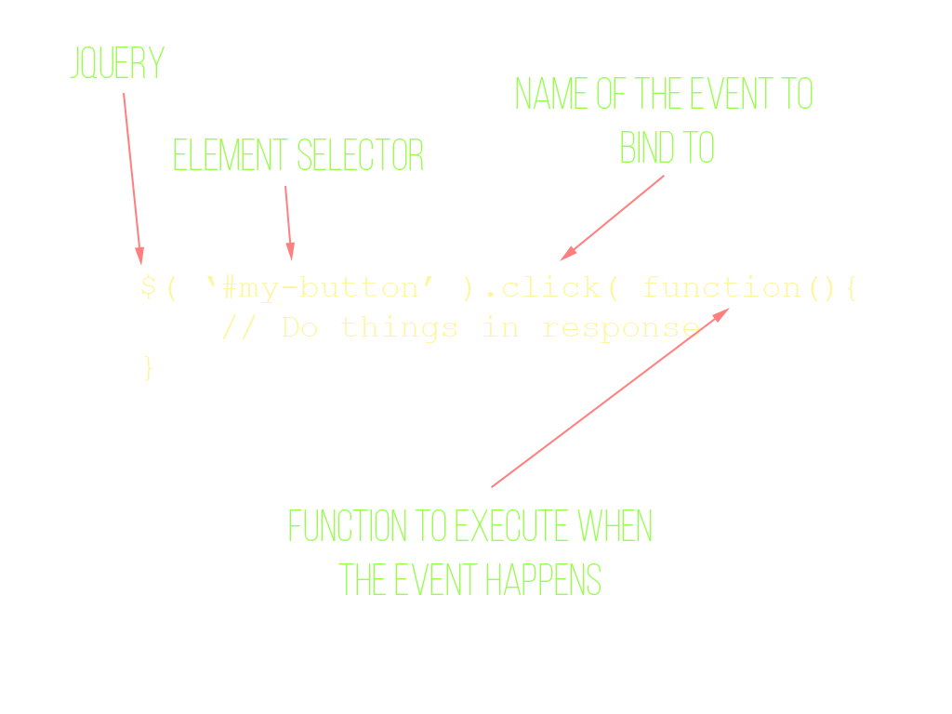
User Interaction

Slide 33
Exercises!
See exercise 7 in the VM

Slide 34
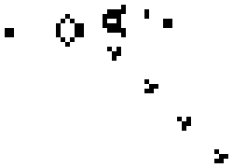
Game of Life
http://en.wikipedia.org/wiki/Conway's_Game_of_Life
Grid of 1x1 cells
Each cell is alive or dead
Follows simple rules for each generation

